Slide 1
Module 3: From Continental to World Power
Talk | Title | Time Period | Date of Talk
16 | Competing destinies | 1848-1854 | March 4th
17 | The Union falls apart | 1854-1861 | March 18th
18 | Civil War | 1861-1865 | Wednesday April 3rd
19 | Reconstruction & the New South | 1865-1900 | April 15th
20 | Conquest of the West | 1865-1890 | April 29th
21 | Triumph of capital | 1865-1894 | Wednesday 8th
22 | A world power emerges | 1890-1904 | May 20th

Slide 4
American History
1
Talk 17: The Union collapses 1854-1861

Slide 5
Overview
Abolitionism
Trouble in Kansas
John Brown
1860 and the election
Secession
War
The South and age of “King Cotton”
Mid 19th Century life

Slide 6
Slavery in the United States 1600-1820
First slaves imported from Africa 1619
1688 Quakers in Pennsylvania make “Petition against Slavery”
1770 s- 1804 Second ‘Great Awakening” ‘Gradual abolition of slavery’ in Northern States– “
1790’s + Introduction of cotton gin makes slavery economically viable
1790-1803 Haitian Slave Revolt
1807/ 08 British and US bans Atlantic Slave Trade
1816 Creation of American Colonisation Society
1831 Nat Turner Revolt
1833 British Empire Abolish slavery (with compensation to owners)

Slide 7
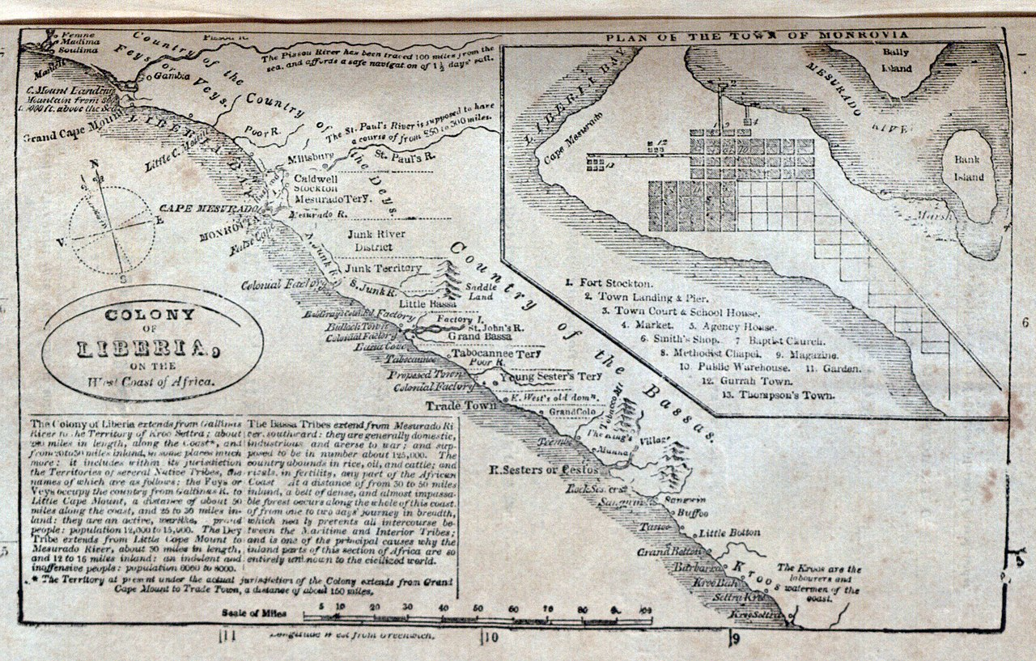
Liberia Colony
Precedent: British West African Colony off Sierra Leone established 1790’s for Black Loyalists
American Colonisation Society purchases settlements
On West Africa…support from Jefferson, Henry Clay,
Monroe, Madison major slave owners….moderate
Abolitionists
A failed enterprise 12,000 Free blacks move to Liberia by1860
60% die from disease within 2 years survivors attacked
by surrounding Kingdoms, survive by becoming “enslavers”. Declare
Independence 1843.. descendants form Liberian
ruling class till 1980
Free blacks consider scheme a fraud: Jerome Loguen:
“We recognize in the scheme of African Colonization"]the most
intense hatred of the coloured race, clad in the garb of pretended
philanthropy…...as manifestations of a passion fit only for
demons to indulge in.”

Slide 8
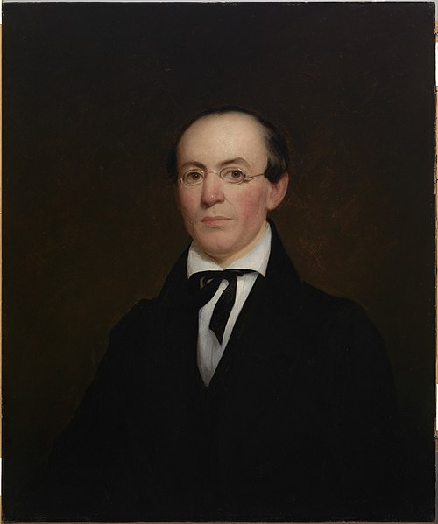
William Garrison (1805- 1879)
Born Massachusetts to Canadian immigrants, employed
as typesetter…then writer, supports ACS but Adopts “gradual abolitionism” 1829
Establishes “Liberator” newspaper 1831….75% readership
Free Blacks…abandons “gradual abolitionism”.
Includes ‘Black Lists” –identifying crimes. Demands
Immediate uncompensated emancipation through
Non violence…South puts price on his head
“I am aware that many object to the severity of my language; but is there not cause for severity? I will be as harsh as truth, and as uncompromising as justice. On this subject, I do not wish to think, or speak, or write, with moderation. No! No! Tell a man whose house is on fire to give a moderate alarm; tell him to moderately rescue his wife from the hands of the ravisher; tell the mother to gradually extricate her babe from the fire into which it has fallen; – but urge me not to use moderation in a cause like the present. I am in earnest – I will not equivocate – I will not excuse – I will not retreat a single inch – and I will be heard.”

Slide 9
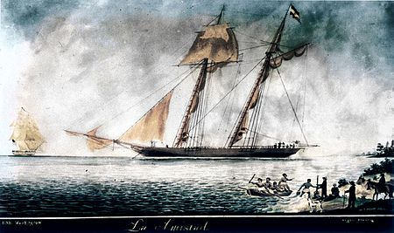
Amistad Incident
Atlantic slave trade abolished
By Britain… British West India
Squadron enforces….with
Increasing effectiveness
February 1839 500 slaves from 9
Ethnic groups captured in West
by Africans employed by Spanish
Slave Pedro Blanco Africa,
Agents Ruiz & Montez smuggle
Slaves to Cuba
Spanish slave owner transports
55 Slaves from Havana to South
Cuba on La Amistad
Cook jokes to slaves they are
Being sent to be cooked

Slide 10
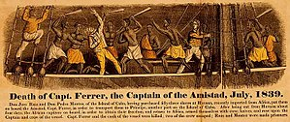
Amistad Incident 1839
Slaves revolt…kill captain and cook take
over ship, imprisons Luis & Montez. Leader Joseph Cinque orders pilot to return to Africa
Pilot tricks slaves….goes to US. US navy intercepts
Slaves. Release L&M, imprisons slaves
The trial: (1) slaves salvage, property of US
Navy(2) property of Luis & Montez to be returned
(3) murders to be hanged (4) ‘people’ resisting
unlawful imprisonment
Slaves acquitted. Navy appeals to Supreme Court
….enter John Quincy Adams (“grandfather
Eloquent” ….fmr President
Joseph learns English….strong defence. acquitted
…..44 surviving slaves return to West Africa
Widely publicized…popular play “The long black
schooner inspires Abolitionists and free blacks
….joy in northern press & Liberator disturbs South
… British navy destroys slave depot

Slide 11
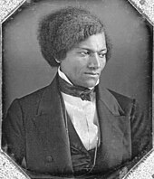
Frederick Douglas (1817-1895)..early life
Born into slavery Maryland, father white
..separated from mother and sold at
Aged 7, mistress taught him alphabet,
Master opposed…learns to read from
White boys
Sold to poor farmer “slave breaker” in
Baltimore. Whipped…retaliated and beat up Master…falls in love with “free” Ann Murray
Escapes to Pennsylvania…protected by Quakers
“"I felt as one might feel upon escape from a den
of hungry lions." Anguish and grief, like darkness
and rain, may be depicted; but gladness and joy,
like the rainbow, defy the skill of pen or pencil.^{[45]}
Considers “Christianity Of America blasphemous
…advocates “Christianity of Jesus”
Writes best seller “Narrative of Frederick Douglas”
An American Slave

Slide 12
Douglas in British Isles
Master…Thomas Auld despatches ‘slave catchers”…Garrison arranges tour of British isles
Experience in Ireland “Eleven days and a half gone, and I have crossed three thousand miles of the perilous deep. Instead of a democratic government, I am under a monarchical government. Instead of the bright, blue sky of America , I am covered with the soft, grey fog of the Emerald Isle [Ireland]. I breathe, and lo! the chattel [slave] becomes a man. I gaze around in vain for one who will question my equal humanity, claim me as his slave, or offer me an insult. I employ a cab—I am seated beside white people—I reach the hotel—I enter the same door—I am shown into the same parlor—I dine at the same table—and no one is offended.... I find myself regarded and treated at every turn with the kindness and deference paid to white people. When I go to church, I am met by no upturned nose and scornful lip to tell me, 'We don't allow niggers in here!'
Astounded by poverty…..meets and befriends Irish nationalist Daniel O'Connell
Tours England….sold out speeches…British abolitionists buys his freedom

Slide 13
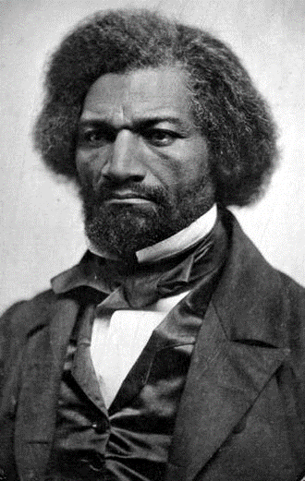
Frederick Douglas: abolitionist
Douglas aged 45 (1861)
Returns to USA 1848 funded by British abolitionists
…..founds newspaper, writes
Writes to former owner …about slave experience
Then “there is no roof under which you would be more
safe than mine, and there is nothing in my house which
you might need for comfort, which I would not readily
grant. Indeed, I should esteem it a privilege, to set you
an example as to how mankind ought to treat each other.
…..meet and reconcile after Civil War"^{[53]}
Meets Garrison….who publicly burns Constitution
Douglas disagrees…lobbies to amend Constitution
Meets John Brown…rejects use of violence
Seeks alliance with Women’ Right movements and
Wealthy White American “Elizabeth Stanton”
Complex personal life. Remains married….multiple affairs
& mistresses but discrete…dresses to impress

Slide 14
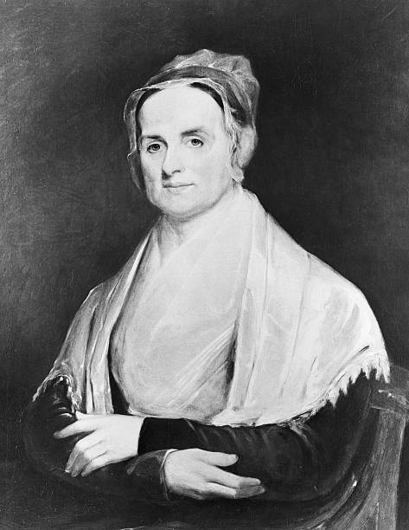
Lucretia Mott (1793-1880)
Born into one of founding Family’s Boston…educated by Quakers….school teacher..motivated To support women's rights by unequal Pay for women, marries
James Mott Anti slavery businessman
Recorded as minister aged 28, James &
Lucretia found American Anti Slavery
Society 1839…famous for speeches
..with Grimke sisters and black preachers
At burning of Boston Meeting Hall
Attends World Slavery Convention London
1840…becomes ally and mentor to
Elisabeth Stanton. Committed support of underground
Railway…supports abolition and women's
Rights…advocates female suffrage, right
to divorce and owning property
Considered leading white female
Abolitionist & found suffragette USA

Slide 15
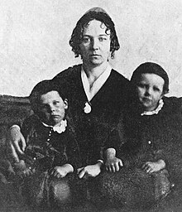
Women’s Suffrage Movement
Elizabeth Stanton (1815-1902) &children
Born Elizabeth Cady to wealthy NY family, father
Federalist, Mother Progressive, only survivor or 7…
Well educated…family encourages
Marries abolitionist…..(refuses to “obey” …radicals, meet Garrison honeymoon to London attends World Anti Slavery Convention on honeymoon…meets Lucretia Mott Frederick Douglas …reveals racist views…Douglas corrects her…
Moves to Seneca Falls NY…meets with
Quakers…movements across US…Mississippi
& Pennsylvania
Works with Lucretia Mott to arrange 3 day Conference for women + abolitionist supporters …men to attend Day one…..but stay quiet
Drafts “Declaration of Sentiments”

Slide 16
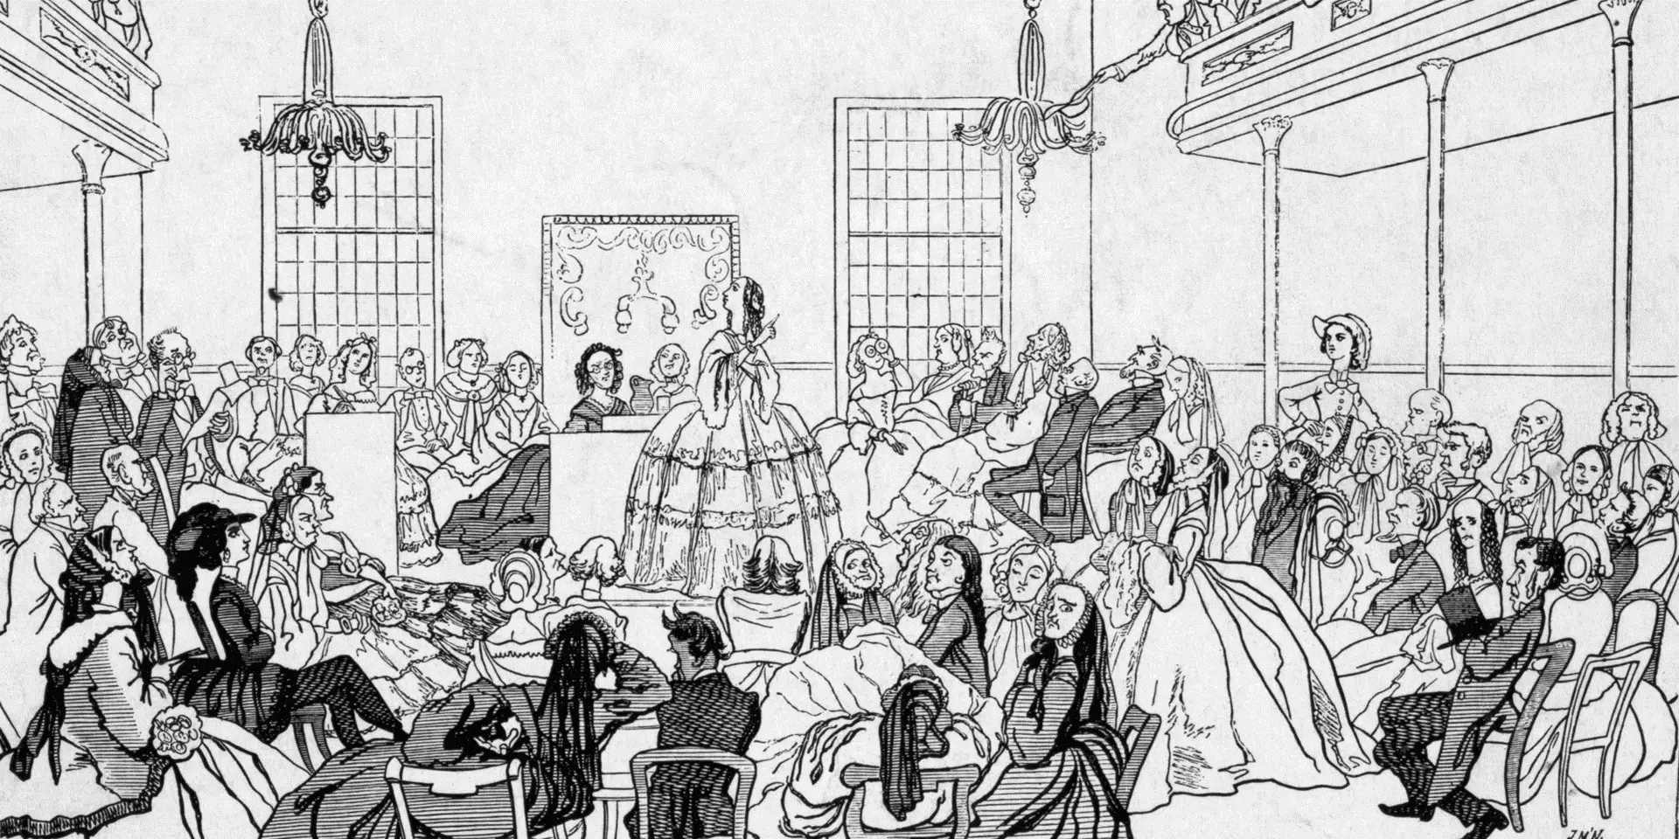
Seneca Falls Convention 1848
Three day Conference Women only day one, Men& Women together days two – three
Debate whether to lobby for women’s vote. Douglas,only black delegate, asked to speak

Slide 17
Outcomes
Douglas: “In this denial of the right to participate in government, not merely the degradation of woman and the perpetuation of a great injustice happens, but the maiming and repudiation of one-half of the moral and intellectual power of the government of the world”…….. Secures women suffragette support for abolitionism
Published “Sentiments” request (1) end slavery, (2) introduction of Temperance, (3) and women rights & suffrage……….publicised across US
Seneca Falls Gazette 1849 “"This bolt is the most shocking and unnatural incident ever recorded in the history of humanity. If our ladies will insist on voting and legislating, where, gentleman, will be our dinners and our elbows? Where our domestic firesides and the holes in our stockings?“
Women become key to success of “Underground Railway”

Slide 18
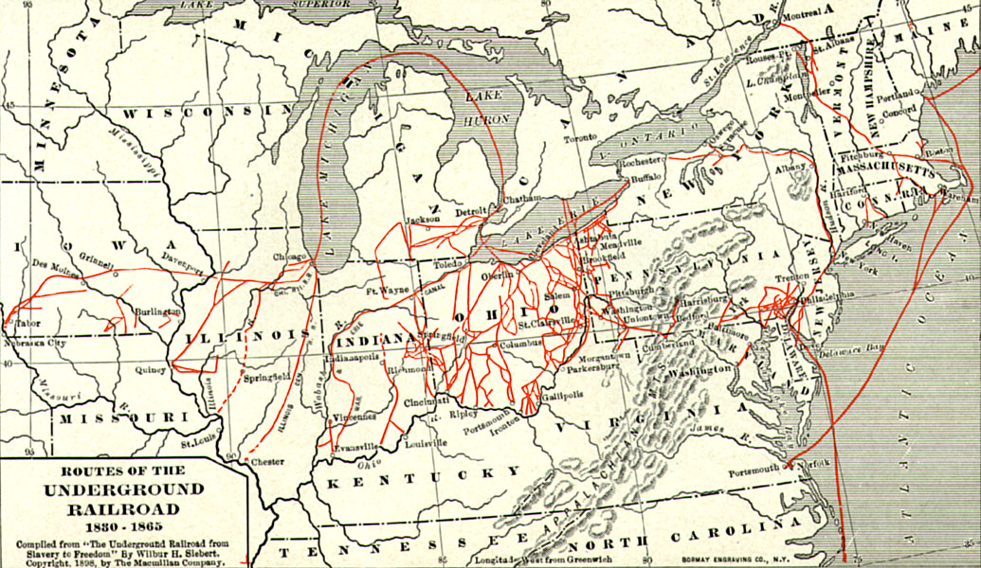
Underground Railway
Fugitive Slave Act required
Northern states to return slaves
Informal network of secret
Societies dedicated to
Smuggling slaves to Canada
…disappeared,,,like underground
Alliance free blacks, Quakers
Presbyterians…...
100,000 slaves escape…30,000
To Canada…most famous
Harriett Tubman…13 trips from
North…100 slaves
Slaves also escaped to Mexico
….Texas Rangers redeployed
As “Slave catchers”

Slide 19
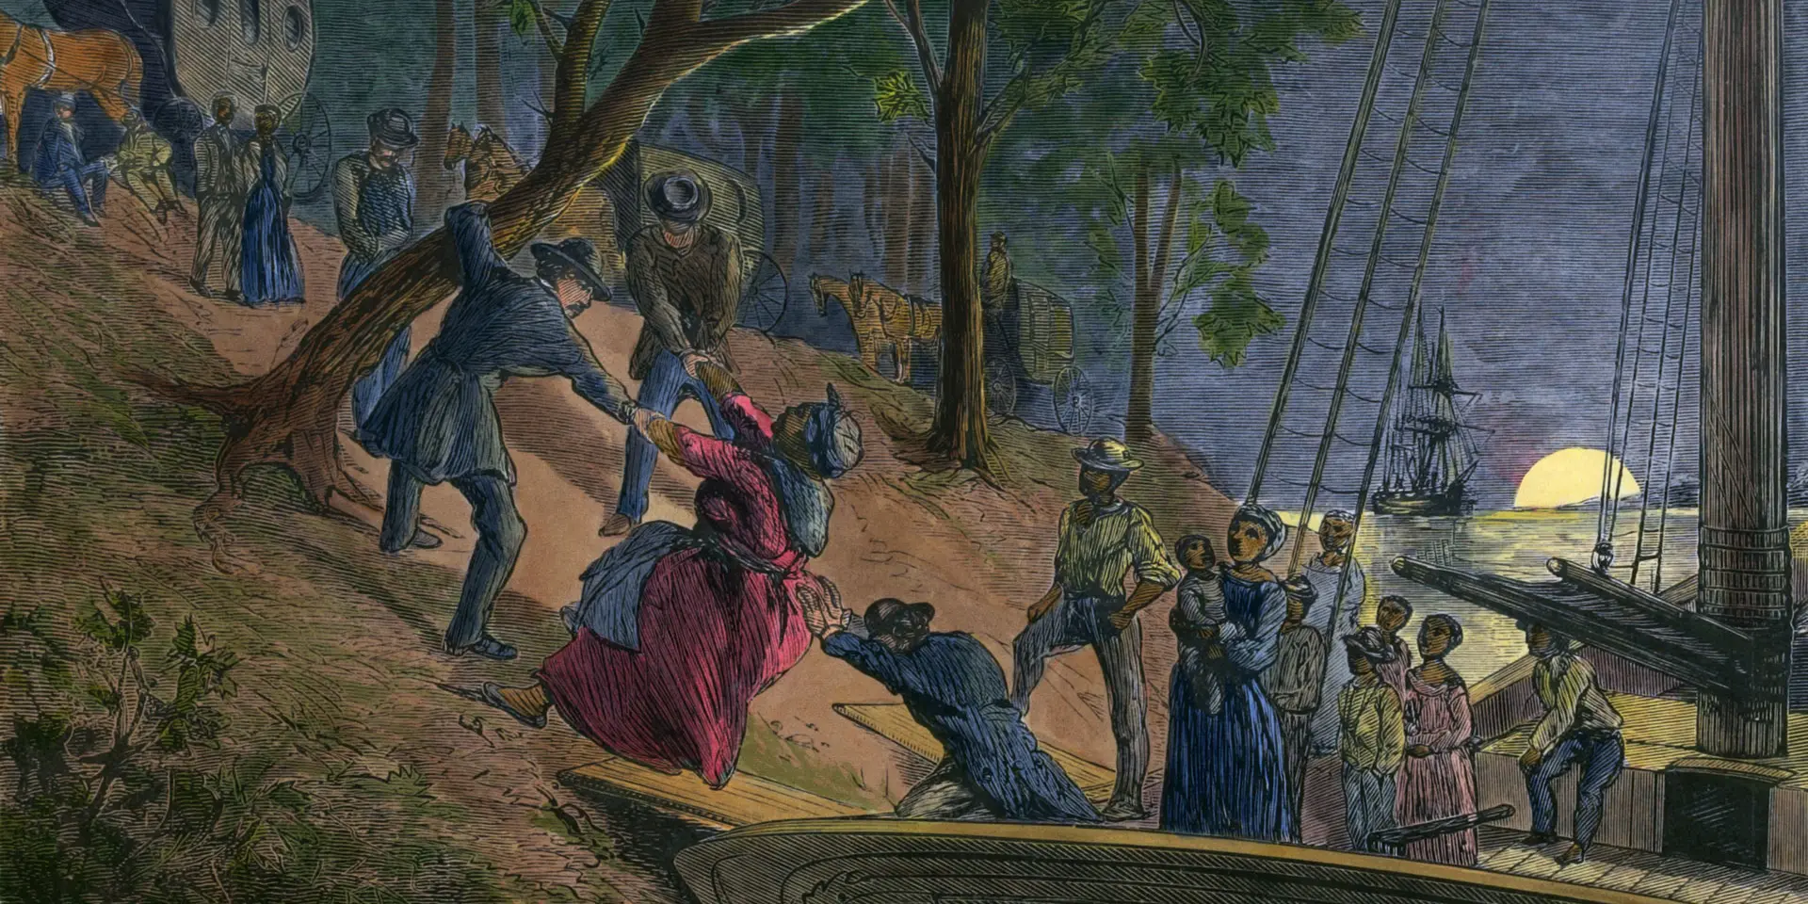
“Underground”..boat and road…to Canada and North

Slide 20
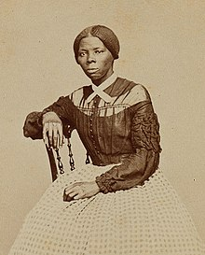
Harriett Tubman (1822-1913)
Born ‘Arminty” slave in Maryland, large Family ….hired “in house” as nurse maid. Whipped. Hired out as teenager…whipped, Head injury. Visions…devout Methodist…Marries free black
Harriet ill…low value…family tries o sell. Flees to Philadelphia 1849 …resolves to rescue Entire family
Completes 13 missions…rescues brothers,
Sisters, parents…husband remarried…70 in total
“I was conductor of the Underground Railroad
for eight years, and I can say what most conductors can't
say – I never ran my train off the track and I never lost a
Passenger”…carried revolver…threaten to shoot anyone
Wanting to return
Befriends Frederick Douglas….assist John Brown to plan raid
…cook in Civil War….scouts for coloured regiment that
recovers 700 slaves….active suffragette after war

Slide 21
Why no mass slave revolt ….Haiti, Jamaica
Outnumbered white population (except S. Carolina, parts of Georgia)
Isolated….away from coasts…lack of interaction
Uneducated…no maps, “Canada”…
Most in small groups under 20
Rigorous Southern ‘Slave Patrols’ infrastructure to control movements

Slide 22
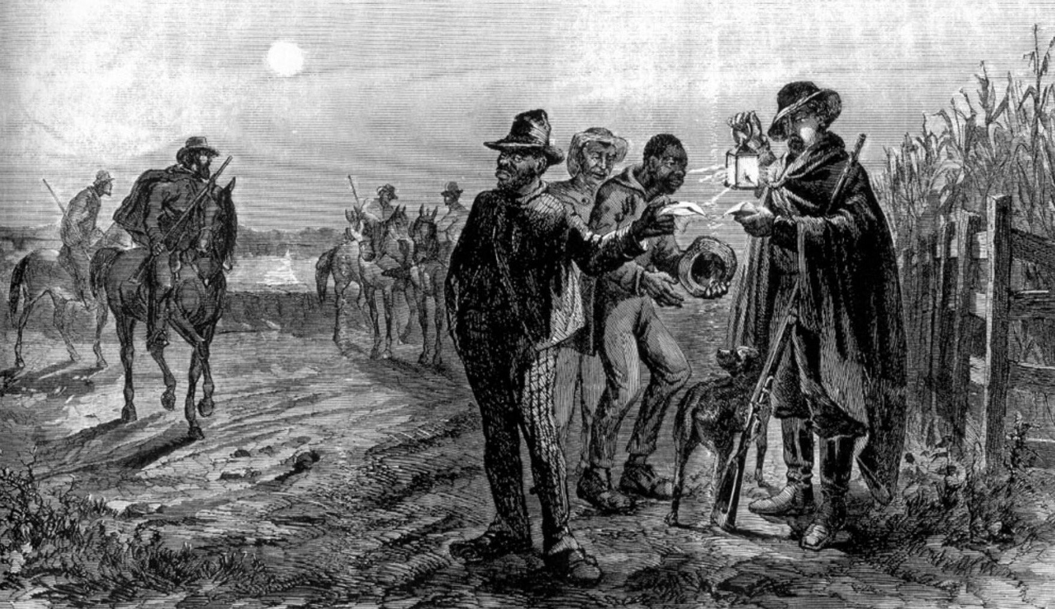
Slave Patrols
State militia continuously
Patrolling countryside
Require proof of “permission
to move” Free Blacks to
Prove status when questioned
..banned some states
Origins of US Police
Force…regulation
Of movement by
blacks

Slide 23
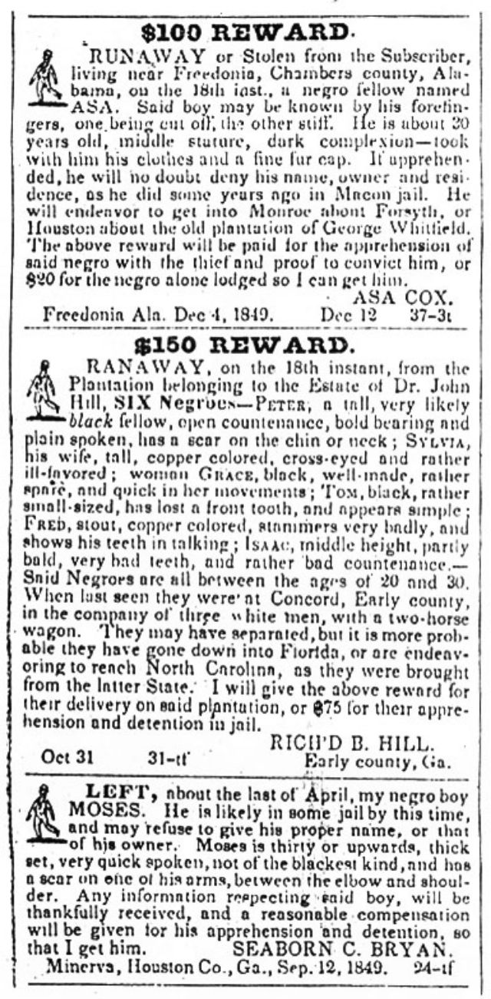
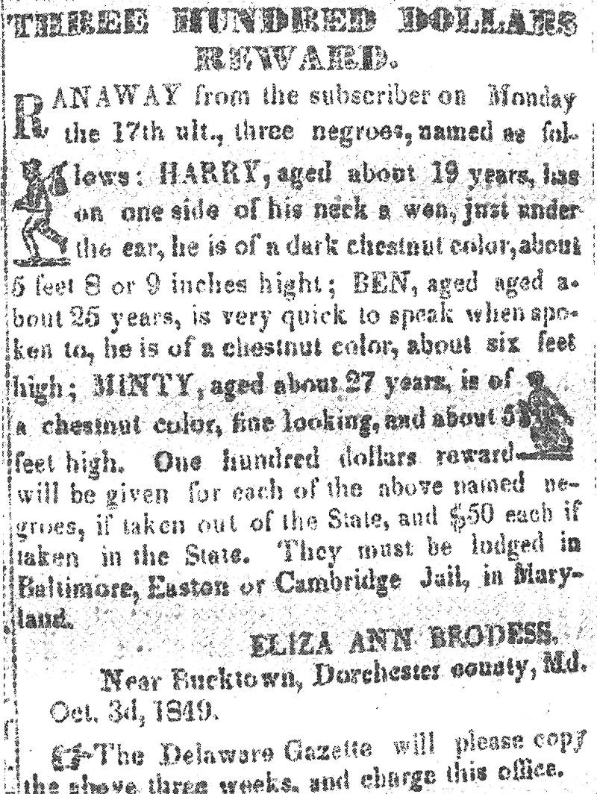
Catching Runaways
This for Harriet (Minty) Tubman
Reward $100 (£3,000) for capture of
Harriet…$50 if found within State

Slide 24
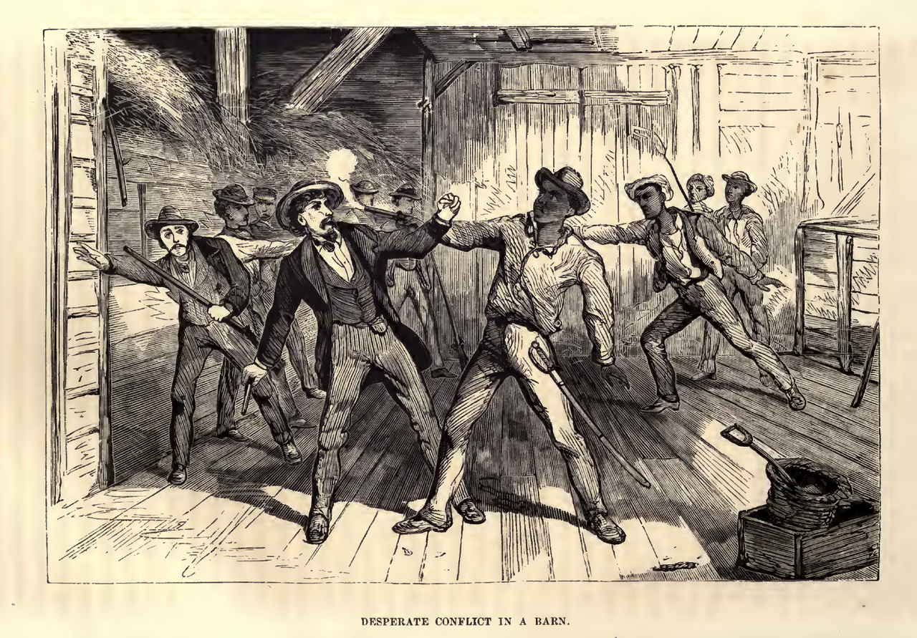
“Slave Catchers”
Northern State pass “ personal
Liberty laws” securing freedom
For local blacks
Slave owners hire “bounty hunters”
To recapture slaves…also “Reverse
Underground Railway”…agents go
North to ‘kidnap’ former slaves….
Or free blacks..
Fugitive Slave Act 1850 required
Northern officials and citizens
To cooperate….origins of US Police
Force…cooperate with “Catchers”
Margaret Garner. Raped slave…children from
Master escaped to Ohio 1853. Catcher finds
her….kills daughter to avoid future rape
Catcher Takes her south…Steamboat sinks
…drowns other daughter. Tries to kill self
….sold as House servant!
..escapes to Ohio
.

Slide 25
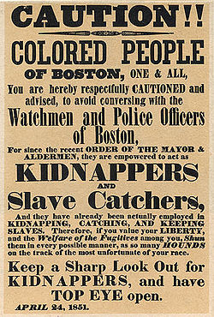
Abolitionist reaction: ”Boston Vigilance Committee
Inter Racial Committee formed
1841 to prevent return of slaves
Many incidents…each “Removal”
Publicised…demonstrations….media
Frenzy…Donations purchase freedom
of Captured slaves…organise rescues
“Slave Catching” becomes too
Expensive to pursues
….South concludes North breaching
“Fugitive Slave Act 1850”)

Slide 26
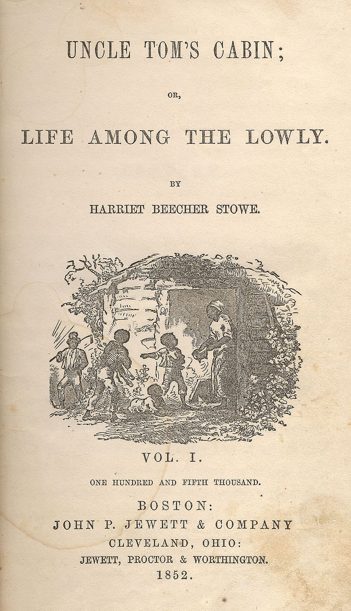
Uncle Toms Cabin 1852
Harriet Beecher Stowe…daughter Of “2nd Great Awakening” preacher
Melodramatic…stereotype characters: Tom ….…. Subservient. Simon Legree Vicious “Northern” Slaver
Appeals to power of Christian Love…slavery an abomination…Sells 300,000 copies first year ..worldwide Block-buster
Forms northern opinion “Slavery” Unchristian ….destruction of people and their families
George Orwell “perhaps the supreme example of
the 'good bad' book is Uncle Tom's Cabin.
It is an unintentionally ludicrous book, full of
preposterous melodramatic incidents; it is also deeply
moving and essentially true; it is hard to say which
quality outweighs the other."

Slide 27
Meanwhile…..back in Kansas

Slide 28
State of Kansas
Population 1854 less than 1,600...”free” settlers…small farms seeking to form government
Kansas Nebraska Act 1854…”residents” to decide “slave or free”
6,000 Missouri Slave owners (Ragamuffins) move into state during 1854
….rig election to vote “pro slave” Governor
Free Settlers reject election…..elect “Free Governor”
One Territory two governments…..both armed
….first killings

Slide 29
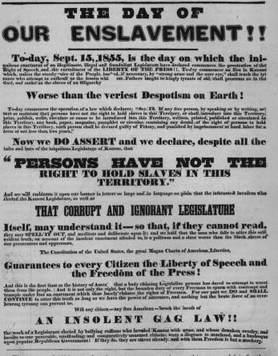
‘Free State’ Response….

Slide 30
Lawrence Kansas 1856
‘Army’ of 800 Ragamuffins ( Pro-Slavers) occupy “Free State” settlement of Lawrence Kansas
…with 1 cannon on May 21st, 1856
Hotel owner decides opportunity to put on buffet lunch
Much drinking, eating…dinner not paid…Slavers demand residents surrender arms
Residents refuse
Ragamuffins fire cannon at hotel …does no damage….burns down hotel & ransack town….1 slaver killed by falling debris
Newspapers….”Ransacking of Lawrence”……message reaches John Brown, abolitionist
Who has joined “Free Settlers”

Slide 31
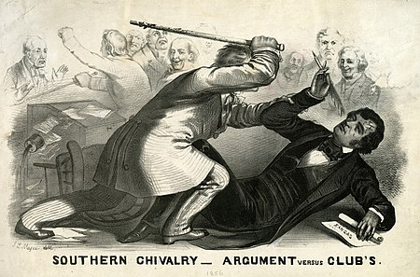
Debating Kansas
“Bleeding Kansas” debated in Senate
Caning of Senator Sumner
Senator Sumner….ridicules South….and relative
Of Congressman Preston Brooks
Brooks attacks Sumner….beats him
senseless …breaks cane.. & leaves for South
South: Richmond Enquirer: "We consider the act
good in conception , better in execution, and
best of all in consequences. These vulgar
abolitionists in the Senate must be lashed into
submission.”…seen as hero, send 100’s new canes
North newspapers public ….South violent fanatics

Slide 32
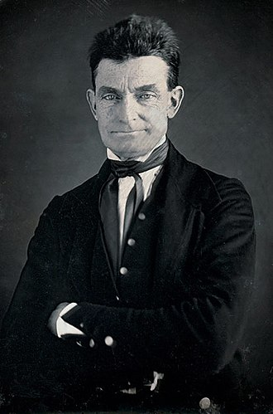
John Brown (1800 -1859)
Born Connecticut…..self educated..
Father abolitionist moves to Ohio. Supporter of
Underground Railway…John herds cattle…sees
Black colleague…beaten with iron shovel….embraces
Anti slavery
Age 16 attends college in Mass…taught by abolitionist
Returns to Ohio…Learns bible by heart, non drinker, non
Smoker, sets up Tannery business + supports “underground”
Marries…7 children, 5 sons…bankrupted Panic of 1836…
moves to Springfield Massachusetts
Successful farmer, breeder of race horses, meets Douglas,
Befriends William Walker (black radical advocate of resistance)
Supports “railroad”…meets Tubman…founds “League of Gilead)
Marries…”End of Days” prevented by slavery
Convinced violence only means to end slavery…moves
To Kansas to support “Free Settlers”...needs trigger to act

Slide 33
Bleeding Kansas
Pottawomie Massacre May 24th 1856
Brown learns of “sacking of Lawrence”. Reads telegraph news of Sumner
Decides revenge, gathers 5 sons and followers
Raids “slavery settlement” of Powattomie, Kansas
Raids homes kidnaps 5 random males….and beheads each of them
Response…..
Kansas “Slave” Governor sends posse to catch/kill Brown
Slaver posse of 30 defeated “at Battle” of Black Jack…June 1856..Brown retreats
Slaver Army of 400 surround Brown at “Battle” of Oswatomie” Brown, 5 sons & 30 conduct ‘fighting retreat’: 20 slavers killed, Brown loses son and 5 supporters
Brown leaves Kansas...on the run
North …Brown hero……South terrorist
Intermittent killings in Kansas continue…..50 killed …press describes as ‘’War’

Slide 34
1856 Election Campaign
Democrats pro slavery
Pro slavery expansion ---Cuba, Nicaragua, Kansas/ immigration…..recruits Irish Catholics
Struggle to select candidate to appeal to North/not alienate south
Chooses “unknown” former Senator Buchanan , northerner, Slavery essential to economy
Republican Party (most Ex Whigs)
Formed 1854 as coalition of “abolitionists” to oppose Kansas Nebraska Act
Northern industrialists ----Only 1 Southern delegate (from Kentucky)
Anti Catholic Immigrants
Selects Celebrity “Western Explorer, Indian Killer, & Gold Rush beneficiary: John Fremont
Native American Party (Make America Great Again) …Know Nothings
Anti immigrant/ Catholic…no opinion on slavery
Labour reform/ women’s rights

Slide 35
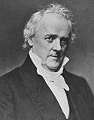
President Buchanan (1791-1868)
Self made…father store keeper…lawyer
Former Senator, Secretary of State, Ambassador to Britain, …had retired from Politics….
Supports “popular sovereignty”, Fugitive
Slave Act”, Purchase of Cuba/Nicaragua
Morally opposed to slavery, but considers
Abolition threat to ‘chivalrous South’
Compromise candidate Policy” compromise by accommodation”…..to South…
Life long Batchelor….wants quiet life with Alabama Senator Rufus King….Rumours
…but society too deferential to question
….commits to running for one term only (till 1860)

Slide 36
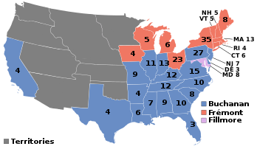
1856 Election
Republicans lose “anti immigrant” Know nothings split Republican Vote
Democrats spread rumour
“Fremont” a secret Catholic
Landslide for Democrats as South unites behind pro slavery platform
…and Republican vote split
Democrats 174 electors (44% vote)
Republicans 114 (33%)
Know Nothings 8 (25%)

Slide 37
Three crisis challenge James Buchanan’s leadership skills…………………… Runaway slave court case + Banking Panic and sinking of gold ship + John Brown led attempted slave revolt
….and reveals that while he has none, an obscure
Congressman from Illinois, Abraham Lincoln does

Slide 38
Intermission

Slide 39
Dred Scott Case 1857

Slide 40
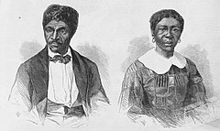
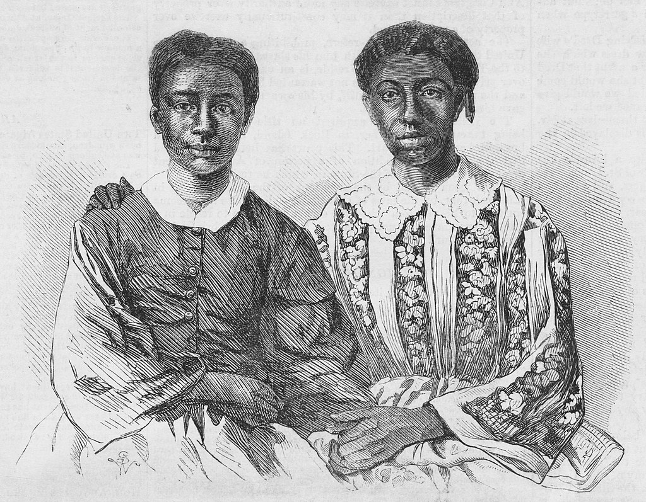
Dred Scott Decision 1857
Dred Scott, wife and daughters
Dred Scott (1799-1858)…born slave to military officer in
Missouri…travels to ‘free states". Marries slave
Two daughters…returns to “Slave State”…appeals
For freedom….since once free
10 years litigation….masters dies….transferred
Abolitionists support…..legal framework prevails
Rejected by Missouri court…appeals to Supreme
Court (while slave and being hired out to various
Masters…law suite funded by Abolitionists)
Supreme Court….Southern Slave Owner
Justice Tawney rules:
……blacks cannot be considered citizens
……Missouri compromise unconstitutional
……local state law trumps national laws

Slide 41
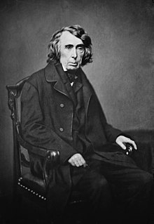
Impact Dred Scott Decision
Chief Justice Robert Taney (1777-1864)
Chief Justice 1836-1864)
Born into wealth Southern plantation family
…considers slavery evil but Southern problem
For South to solve…States rights>Government
Manumits slaves, pensions old when appointed
Georgia newspaper: “Southern opinion upon
the subject of Southern slavery,”, “is now the
supreme law of the land,” `
Chicago Tribune “this is the first step in a
revolution which, if not arrested, nullifies the
Revolution of '76 and makes us all slaves again."
Inflames opinions in North…..upcoming midterm
Elections……Senatorial Race Illinois
John Brown develops plan for slave revolt

Slide 42
Panic of 1857

Slide 43
Panic of 1857
Global markets connected up faster steamships…then broadcast by transcontinental telegraph….(first transatlantic cable 1858..but broke)
Economy booming 1850’s…..the Railroad Economy & Mid West Towns
Confidence reduced by
Declining Gold Yields in California & Australia
Unrest in Kansas
Public debate on Dred Scott
British Government decision to leave Gold Standard
Buchanan asks Reserve bank to require state banks to curtail use of paper money/tighten reserves

Slide 44
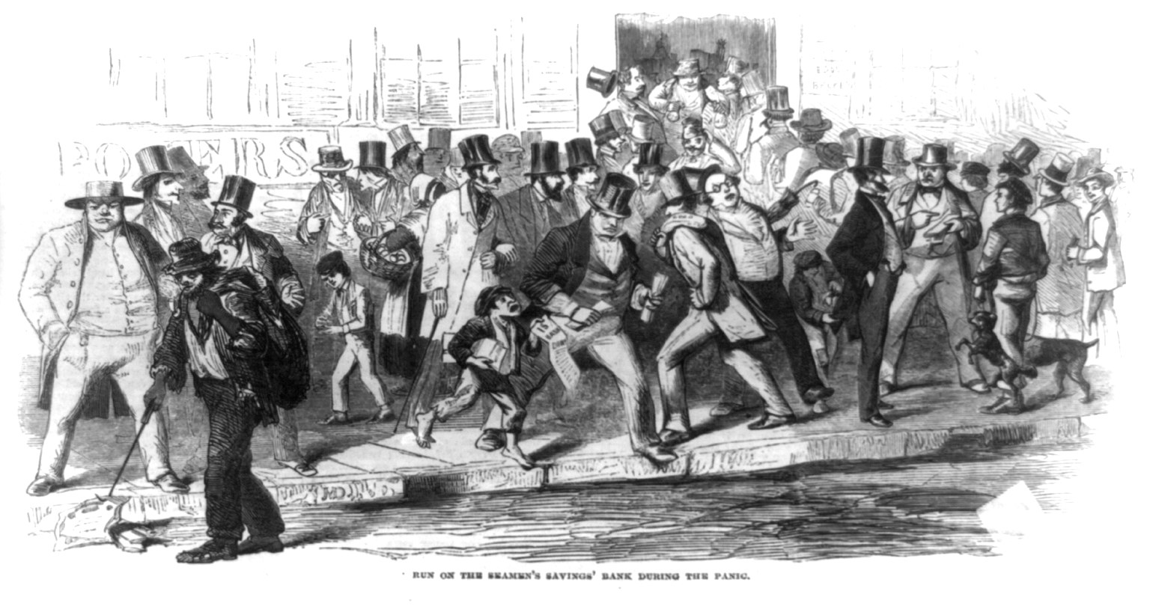
Bank Runs…August 1858
Rumours circulate
….banks unable to meet specie demands…panic
Spread by telegraph
Stock market crashes, railways cut wages, municipalities debts
Unpaid….Mid West property values collapse
South unaffected
….Cotton prices high due to
Indian Mutiny/ Revolution
Government not its job ….wages cut….mass hunger
….Government response accelerate gold shipments from California

Slide 45
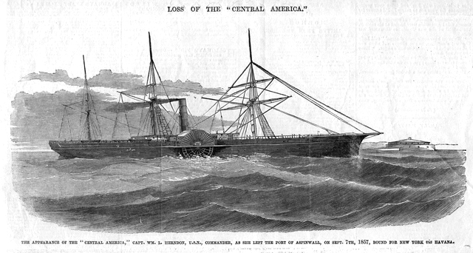
Solution….more Gold
September 1858
“Central America” Leaves Panama with 9 metric
Tons of Gold for New York
....with 500 passengers

Slide 46
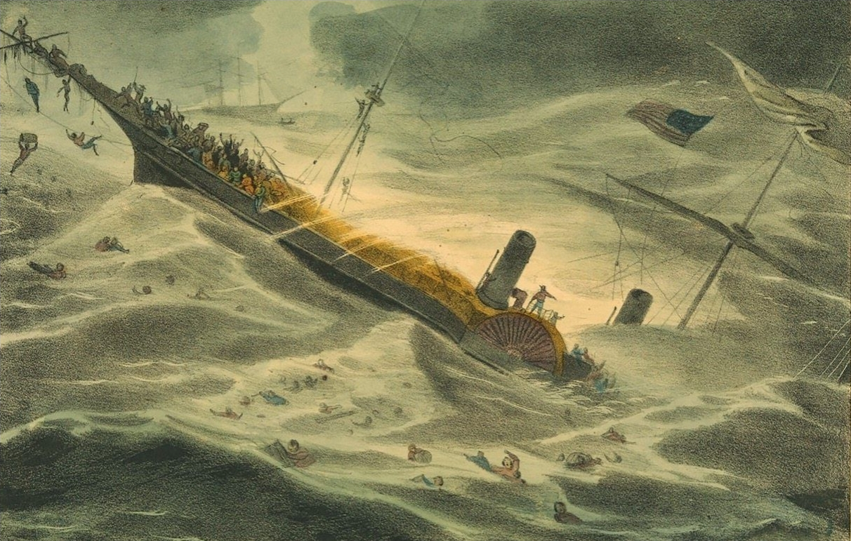
……………Crisis deepens
Sinking of “Central America
September 1857”
400 Passengers drown…along with 3 months supply of California Gold
“Panic” spreads
…grain prices fall 60%
…lots sold for $1,000 in Keook Iowa
Sell for $10 by Spring 1858
(gold recovered 1980’s)
Economy does not recover till civil war
South sees “Crash” proof its economy
Immune from market…sense of
Invulnerability….King Cotton

Slide 47
Emergence of Lincoln

Slide 48
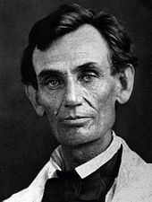
Abraham Lincoln (1809-1865)
Lincoln…1859
Kentucky Log cabin born, father Cabinet make
…moved to Indiana to farm. Abraham lazy
Too much "reading, scribbling, writing, ciphering
, writing Poetry” self educated. Mother dies @
Age 9... Odd jobs ‘rail splitting’ ..family moves
To Illinois…leaves home at 21
Works as storekeeper, partner in Tavern,
Marries Mary Todd 1830 (4 children, 3 to die)
Captain “Black Hawk War” 1831-32….self
Taught lawyer
Illinois State Legislature 1834-1842.
State Representative 1847-49…Whig, Henry
Clay…oppose Mexican War..”spot” speech,
Opposes extension of slavery to new territory
Retires from politics…successful “Prairie Lawyer”
….’honest Abe’….appalled by Kansas
Nebraska Act & Dred Scott decision
….opposes “extension of slavery”
….runs for Senate

Slide 49
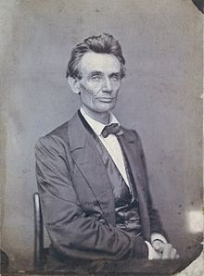
“Little Giant” vs “Honest Abe”
State Senators appointed by State Legislature….Steven Douglas Senator …author
Kansas Nebraska….’Democrat’ superstar….Lincoln …political nobody…challenges
Douglas to 7 debates across Illinois….accuses Douglas of being coward…Douglas accepts
Opposes slavery extension, AND abolitionism….pro repatriation, blacks
Protected by Constitution, unequal, but
human
“States Rights”…freedom of states to choose slavery.. Blacks property. No protection

Slide 50
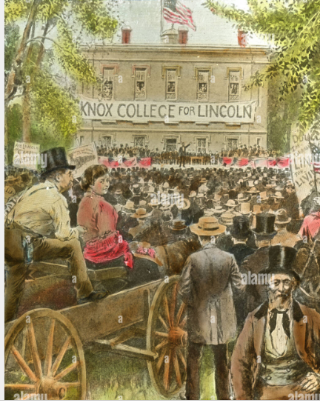
The event of the year
Each candidate 60 minute speech
Plus 30 minute rebuttal
Crowds 10,000- 20,000 each event
Nationwide newspaper coverage
Use of Shorthand..telegraph
Douglas…slavery a controversy, Lincoln
Slavery the problem
Lincoln loses election but becomes
National Figure…‘moderate’ inspirational
& witty leader…New ‘Republican Party”
Achieves credibility….across North &
Midwest

Slide 51
Lincoln ..enigmatic…practical
Asked what is was like being President, “I’m like the man who was tarred and feathered and ridden out of town on a rail. When they asked him how he felt about it, he said that if it weren’t for the honour of the thing, he would rather have walked.”
Douglas accused Lincoln of being two-faced. Replied Lincoln calmly, “I leave it to my audience: If I had two faces, would I be wearing this one?”
Positions himself as “moderate” man of his times …..White Supremacist….at least in 1858
“And I will say in addition to this that there is a physical difference between the white and black races
which I believe will forever forbid the two races living together on terms of social and political equality.
And inasmuch as they cannot so live, while they do remain together there must be the position of superior
and inferior, and I as much as any other man am in favour of having the superior position assigned to the
white race."
……………..His views will change

Slide 52
John Brown’s Revolution

Slide 53
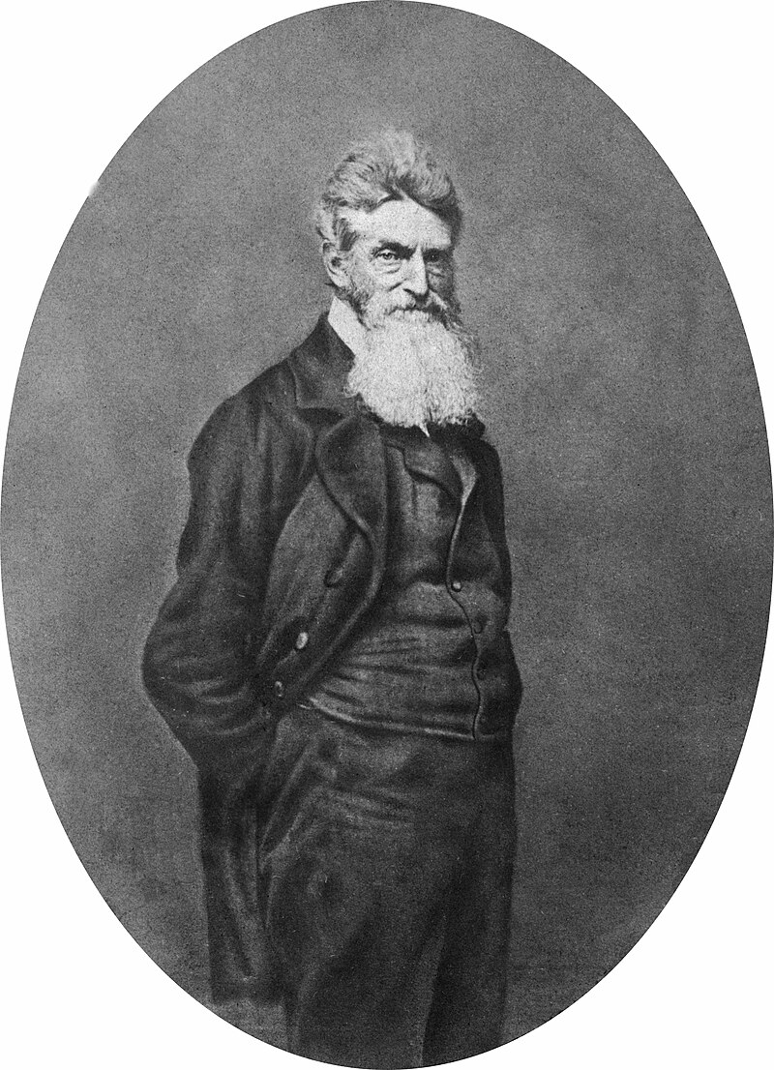
John Brown….continued
John Brown 1859
Retreats from Kansas after ‘battle of Oswatomie”
In 1856 …on the run from Southern pro slavers
…and Federal Government for murders. Grows beard
The idea: seize federal arsenal at Harpers Ferry
And summon slaves to rise up and kill masters,,
March south…..uprising all plantations
Secures funding from “Secret Six". Wealthy
Abolitionists….meets Frederick Douglas, Garrison
Harriet Tubman. William Garrison…considers plan
Suicidal….goes to Canada To recruit black runaways
….few join
Returns to Kansas with 5 sons…..raid…rescues
11 slaves…assembles ‘army’ of 25 (including 4
Free blacks and heads for Harpers Ferry

Slide 54
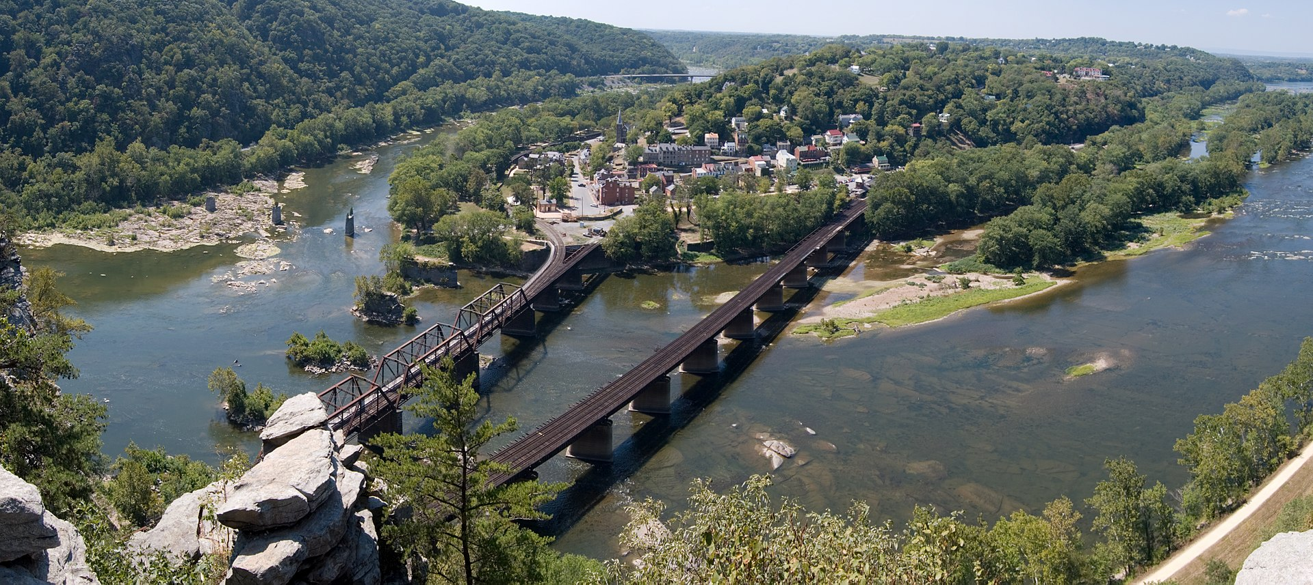
Harper’s Ferry West Virginia
Arsenal

Slide 55
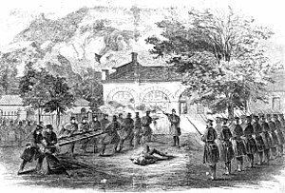
Harpers Ferry October 16-19 1859
Arsenal..100,000 muskets
Stored….1 night watchman
Brown’s army seizes arsenal
And waits for slave rising
…expect 1,500 next day
…allow train through town
Alert telegraphed across state
Local residents surround
Arsenal…gun battle 4 killed
State calls in US Marines
Led by Robert e Lee…
Storm building 10 Brown’s
Men & 1 marine killed. Brown
+ 5 captured, 5 escape

Slide 56
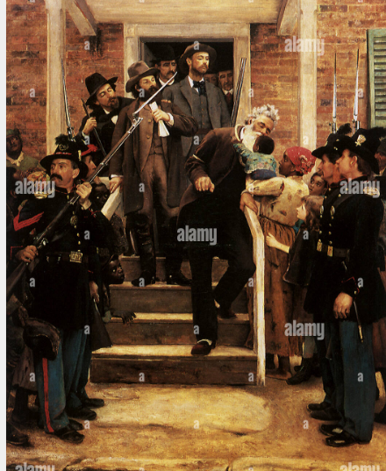
John Brown execution, December 1859
Trial a national sensation
..newspapers, telegraphed
Across country
Brown gives interviews to
Press….hero and martyr to North,
Terrorist to South
'there are moments when men can
do more dead than alive.'
I...am now quite certain that the
crimes of this guilty land can never
be purged away but with blood.
I had, as I now think, vainly flattered
myself that without very much
bloodshed, it might be done."

Slide 57
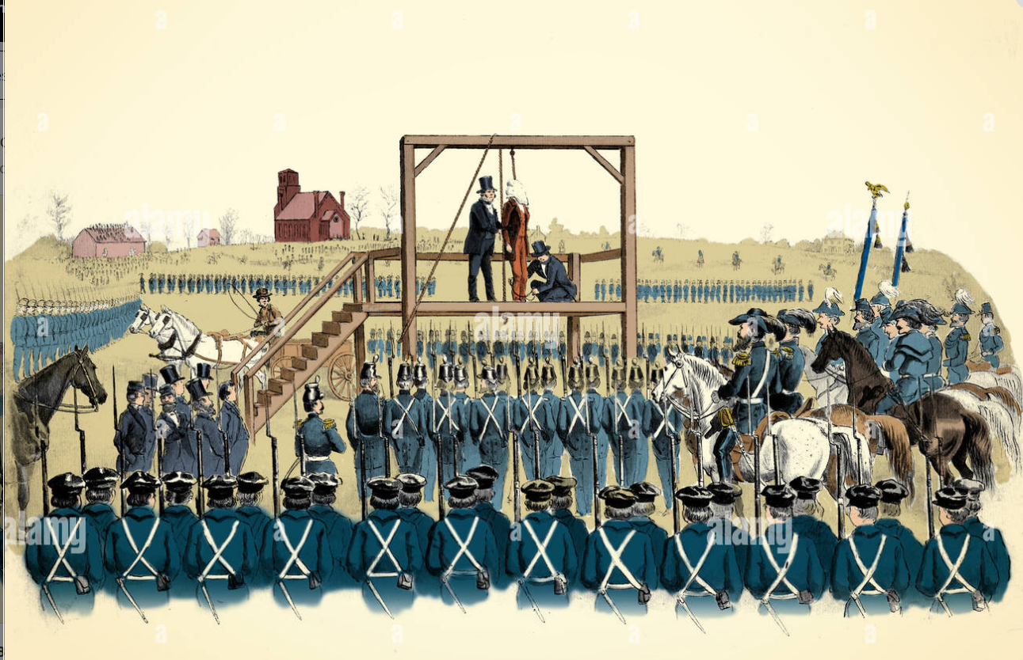
Public event….watched by 2,000 soldiers ….and press

Slide 58
Election of 1860

Slide 59
Candidates
Democrats splits into North and South
North….Catholics unemployed, want government intervention. Picks Steven Douglas “Little Giant”
South…King Cotton…indifferent to North…seek slavery expansion. Picks Southern Slave Owner
Republicans
Seek to avoid appearing too radical….can’t agree. Multiple ballots
Select Lincoln ..moderate, promise of high tariffs, no slavery expansion
Know Nothings…collapse…reform as “Constitutional Union” Party
Avoid mentioning slavery
One idea….reduce Catholic immigration

Slide 60
The Campaign
Candidates do not campaign…..”office to the man, not man to office”
Republicans
Creates “Young America” movement....Lincoln the future. First of its kind
Portray Lincoln as moderate…pro “White Supremacy” slavery to be preserved but not expanded
Democrats response
Lincoln as “negro lover”, ignorant country boy,
Southern states threaten to leave union if Lincoln elected
Southern election organisers ban all ballots for Republican party and Lincoln in 10 Southern State

Slide 61
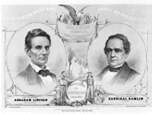
Lincoln campaign poster

Slide 62
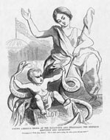
“Young America” (strangling serpent of disunion)

Slide 63
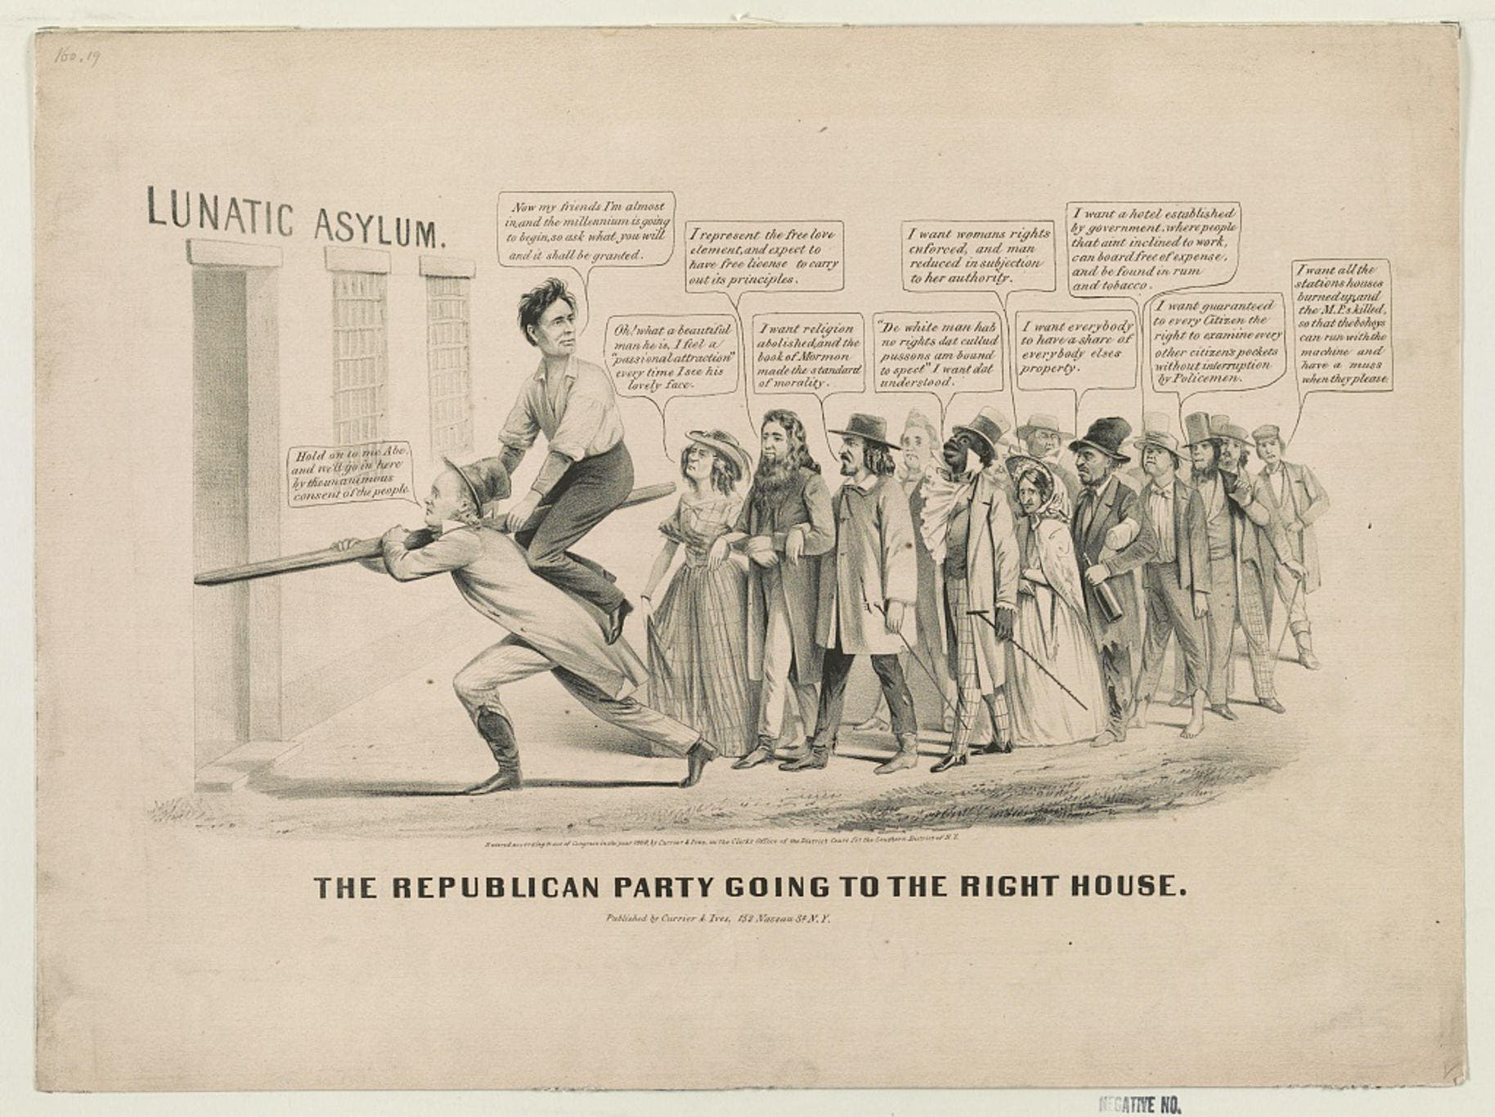
Democrat Cartoon….Radical Republicans (abolition, women’s votes, equal rights for blacks, anti religion……Lincoln a country bumpkin….leading nation to Lunatic Asylum….

Slide 64
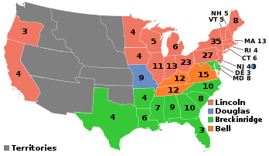
Results: US “most consequential election”(till now?)
5 million votes cast…50% increase
Lincoln wins 180 electors (40% vote)
South Democrats 72…(18%)
Unionists 39 (12%)
North Democrats 12 (30%)
Lincoln wins with lowest percent of
Popular vote in US history
South convinced Lincoln will end slavery, and decide to secede
Lincoln “President Elect". But
Can do nothing… Buchanan
In charge till March 1861

Slide 65
Secession

Slide 66
Lincoln Inauguration
States hold assemblies and vote to leave the Union
Southern States meet in Montgomery Alabama to form the “Confederacy of America”
South Carolina | December 20, 1860
Mississippi | January 9, 1861
Florida | January 10, 1861
Alabama | January 11, 1861
Georgia | January 19, 1861
Louisiana | January 26, 1861
Texas | February 1, 1861

Slide 67
King Cotton
Southern Senator:
“Without firing a gun, without drawing a sword, should they make
war on us, we could bring the whole world to our feet ... What
would happen if no cotton was furnished for three years?
... England would topple headlong and carry the whole civilized
world with her, save the South.
No, you dare not to make war on cotton.
No power on the earth dares to make war upon it.
Cotton is king.”

Slide 68
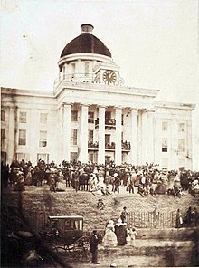
The Confederacy is born
Jefferson David inauguration
Delegates from 7 States
Meet February 1861 (before
Lincoln Inaugurated)
Vote to leave Union, create an
Army of 100,000 men, elect
Jefferson Davis President
Southern extremists send
Assassins to kill Lincoln

Slide 69
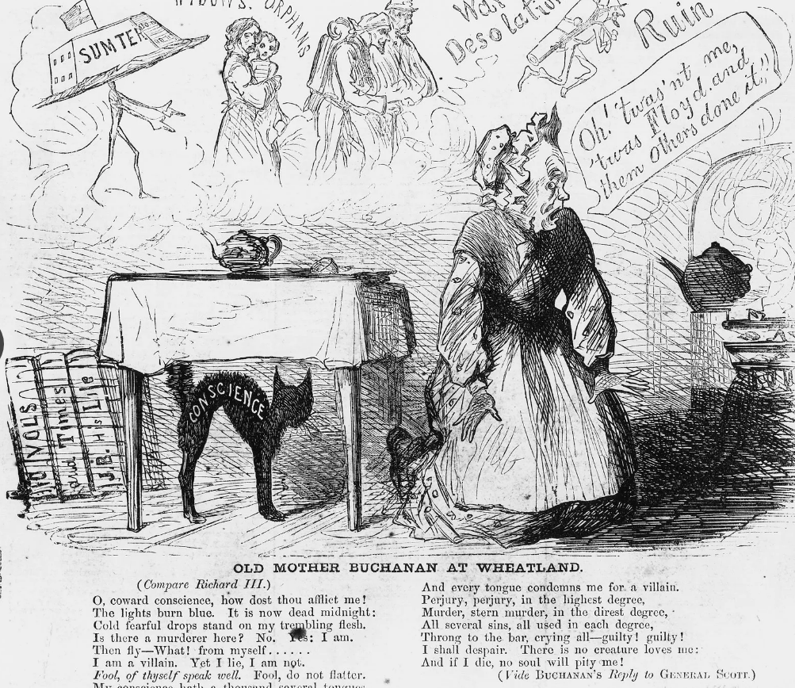
Buchanan response
Lampooned as “Old Granny”
….suggesting of cross dressing
Sets up Peace Conference with
Border States
Accepts South’s right to secede
Calls up no troops, does not reinforce
Forts along Southern Coast
Supports “Corwin Amendment”.
to guarantee preservation of
Slavery to placate South..
passed by Congress …sent to
states for 2/3 approval
….No response events moving fast

Slide 70
Lincoln Inauguration
Lincoln at White House (note crowd size)
Policy of silence between election
November 1860 & inauguration
March 4, 1861
Smuggled into Washington at night
on secret train…arrives an surrounded
By cavalry….assassins flee
Massive crowd wait for speech
Tries to reconcile South
No attempt to end slavery “where it exists”
No attack on South…unless attacked
Will hold and occupy US forts
……but does say “secession” is anarchy

Slide 71
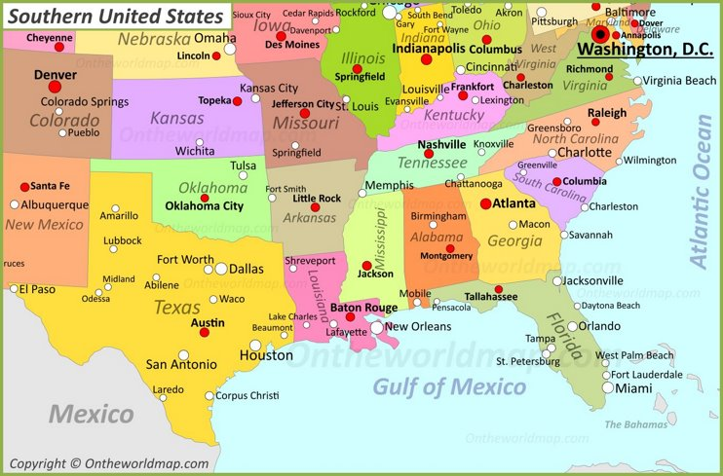
Fort Sumter
One of several forts built along
Southern and Eastern Coast
Fort Sumter
Designed I 1812 to be most
Powerful Fort in world with 650
guns …enemy the British most guns
facing Atlantic……incomplete 1860
Guarded by one soldier…future
Garrison of 100 stationed on land

Slide 72
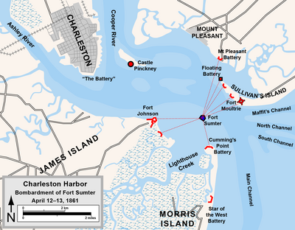
Fort Sumter
Fort will command Charleston
harbour
Commander abandons
Moultrie when S Carolina
Secedes in December
…situation indefensible
Carolinians seize armoury
At Moultrie with 20,000 guns
Assemble artillery
Buchanan shocked…
S Carolina considers move
“act of bad faith”
…Jan 1st demands Fort
surrender
Commander refuses..
Sends note …running
Out of food

Slide 73
“Stalemate”
Buchanan sends ship to supply Sumter with food “Star of the West” in January 9th .
Carolina batteries open fire……relief abandoned
January- March …stalemate…..garrison on short rations. Jefferson Davis does not want be seen as aggressor….fear of alienating Virginia and other border states
Lincoln takes office
Offers to hand over fort if Virginia stays in union “a state for a fort is no bad business”
South sends negotiators.. Lincoln refuses to recognize them
Notifies S Carolina’s that he will send expedition to deliver food. Not arms
Jefferson Davis orders “fort reduced” before food arrives

Slide 74
“War”
Local commander General Beauregard sends negotiators to Fort to secure surrender
Anderson refuses
Negotiator: “Sir: by authority of Brigadier General Beauregard, commanding the Provisional Forces of the Confederate States, we have the honour to notify you that he will open fire of his batteries on Fort Sumter in one hour from this time."
Anderson escorted the officers back to their boat, shook hands with each one, and said "If we never meet in this world again, God grant that we may meet in the next."

Slide 75
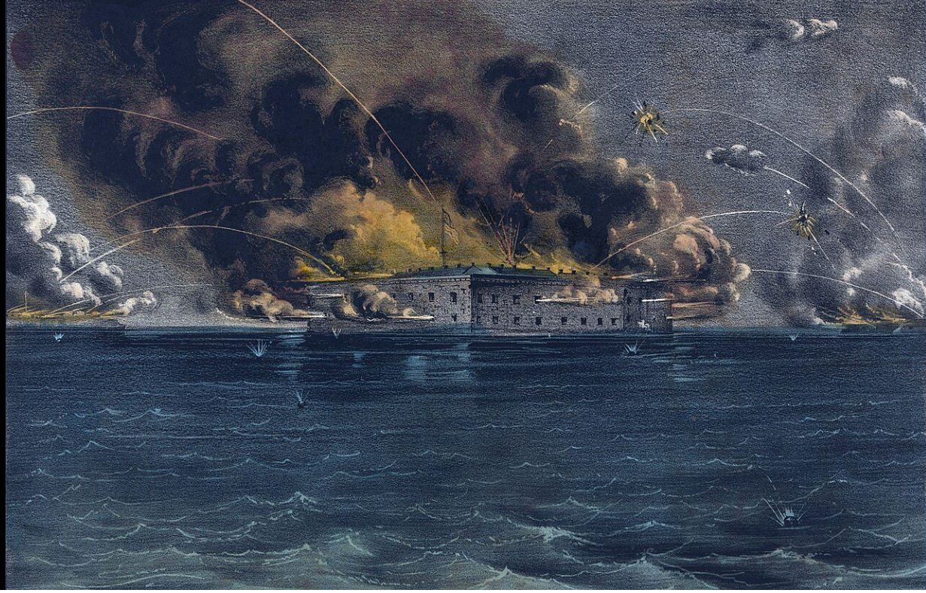
Bombardment…and war start April 13, 1861

Slide 76
Impact of bombardment
Fort surrenders April 14th…..none killed….one dies from accidental explosion
South allows garrison to return north….Anderson a national hero
Lincoln calls for 75,000 troops for 90 days (to recover forts and restore union)
Virginia, Tennessee, North Carolina and Arkansas secede from the union
South moves capital to Richmond Virginia (to keep Virginia in Confederacy)
Northern and Southern armies assemble 100 miles apart ready for War

Slide 77
Dixie
Composed 1859 by Northern song writer
Battle song of Southern Armies
Northern version a parody

Slide 78
Dixie Land……Southern Version
I wish I was in the land of cotton, old times there are not forgotten, Look away, look away, look away, Dixie Land. In Dixie Land where I was born in, early on a frosty mornin', Look away, look away, look away, Dixie Land. Then I wish I was in Dixie, hooray! hooray! In Dixie Land I'll take my stand to live and die in Dixie, Away, away, away down South in Dixie, Away, away, away down South in Dixie.^{[25]}
Dar is buckwheat cakes in Injun batter, makes your fat a little fatter
Look way! Look away! Look away! Dixie Land
Then hoe it down and scratch your gravel,
To Dixie’s Land I’m bound to travel
Look away! Look away! Look Away! Dixie Land
Then I wish I was in Dixie, hooray! hooray! In Dixie Land I'll take my stand to live and die in Dixie, Away, away, away down South in Dixie, Away, away, away down South in Dixie.^{[25]}

Slide 79
Northern Version
Away down South in the land of traitors, Rattlesnakes and alligators, Right away, come away, right away, come away. Where cotton’s king and men are chattels,Union boys will win the battles, Right away, come away, right away, come away.
We’ll all go down to Dixie, Away, away, Each Dixie boy must understand That he must mind his Uncle Sam, Away, away, We’ll all go down to Dixie. Away, away, We’ll all go down to Dixie.
Oh, may our Stars and Stripes still wave, Forever o’er the free and brave, Right away, come away, right away, come away. And let our motto ever be —“For Union and for Liberty!” Right away, come away, right away, come away.
We’ll all go down to Dixie, Away, away, Each Dixie boy must understand That he must mind his Uncle Sam, Away, away, We’ll all go down to Dixie. Away, away, We’ll all go down to Dixie.

Slide 80
Next time…….The Civil War

